Slide 1
Template Matching and Object Tracking in Videos
Nilanjan Ray
Computing Science
University of Alberta

Slide 2
Agenda
Demos to understand what we mean by visual tracking
Template matching in videos will lead to a simple object tracking algorithm
Speed up of computations will be achieved by hierarchical (aka multiresolution) search
Image pyramid
Baseline object tracking algorithm
Why object tracking is an extremely difficult problem

Slide 3
Tracking demos
Matlab demo
Demo from https://webdocs.cs.ualberta.ca/~nray1/research_ot.html

Slide 4
Template matching to compute motion
Motion vector
Previous frame F_{t-1}
Current frame F_{t}

Slide 5
Template matching to compute motion…
Object in current frame
Object in previous frame (T)
Motion vector
Search window
(I)
Current frame F_{t}
Compute normalized cross correlation between I and T to find motion vector

Slide 6
Speeding up computation
Computational complexity of search?
Number of locations in the search window
How do we reduce this computation?
Hierarchical (aka multiresolution) search

Slide 7
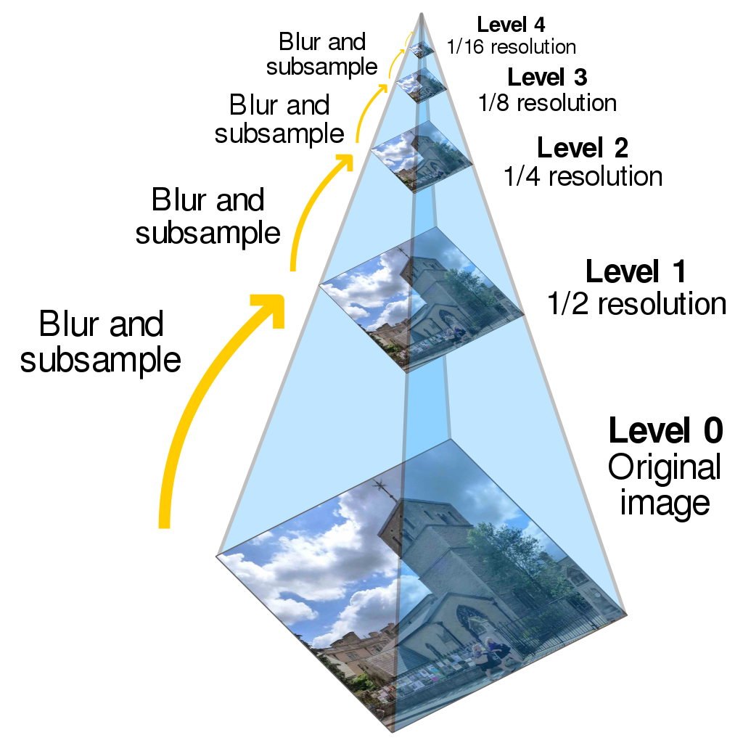
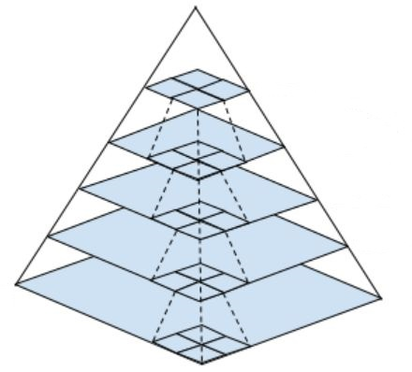
Image pyramid
https://en.wikipedia.org/wiki/Pyramid_(image_processing)

Slide 8
Hierarchical search
motion vector {dx, dy} = {1, 6}
dy
Total number of computations: 9 + 8×2 = 25 (3-step) (2R+1)² = 169 (full search)
dx
(Fig. from Ken Lam – HK Poly Univ. short course in summer’2001)

Slide 9
Speed up using calculus
We will look at another method called Lucas-Kanade tracking when studying optical flow; so, I am deferring the topic for now…

Slide 10
Baseline object tracking algorithm
Initialize tracker (template) on frame 1
For frame 2, 3, …
Search for template within search window (maybe hierarchical search)
Move object location to the location with best match
Update template
How do we deal with occlusion?
How do we deal with multiple objects?
How do we deal with scale change?
How do we deal with illumination changes and shadows?
How do we deal with deformable and articulated objects?

